Slide 1
Conditional Diffusion on
NYU Depth v2
Advanced Deep Learning
Nils Fahrni

Slide 2
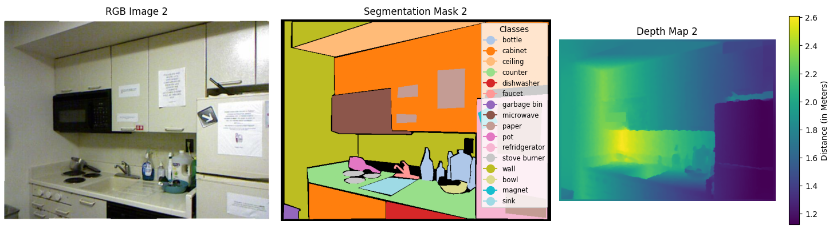
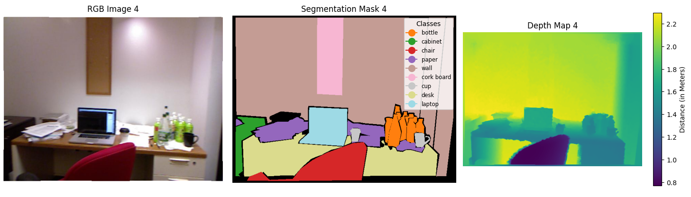
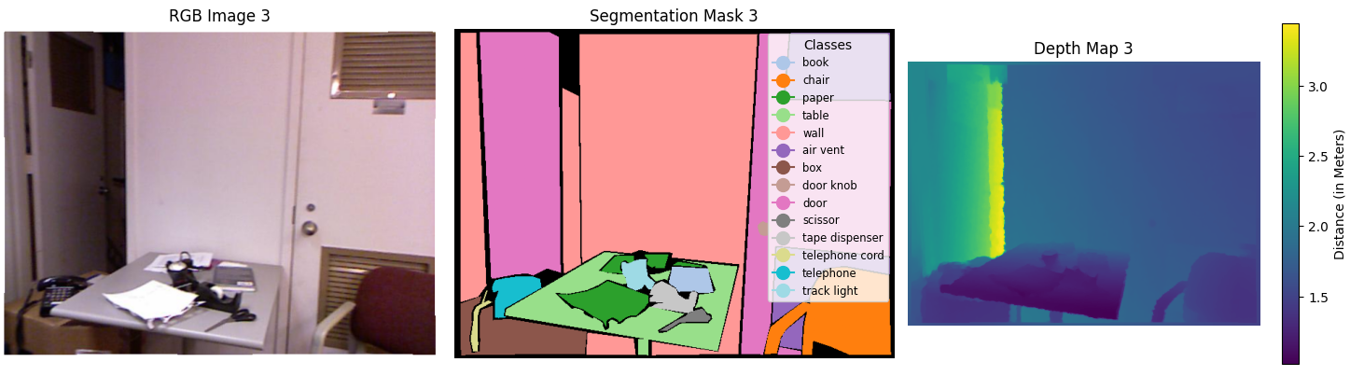
Taking a glimpse into the dataset

Slide 3
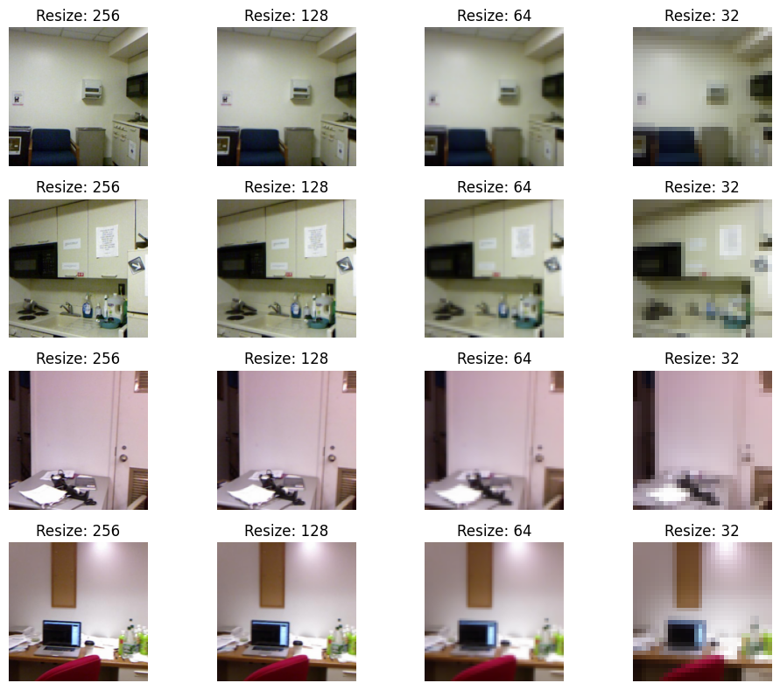
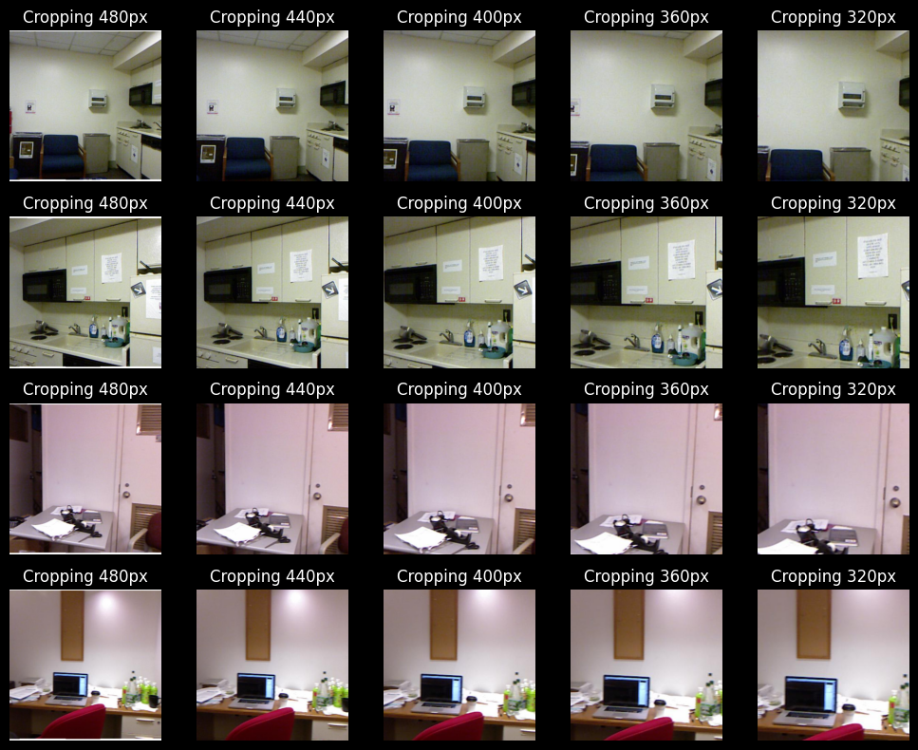
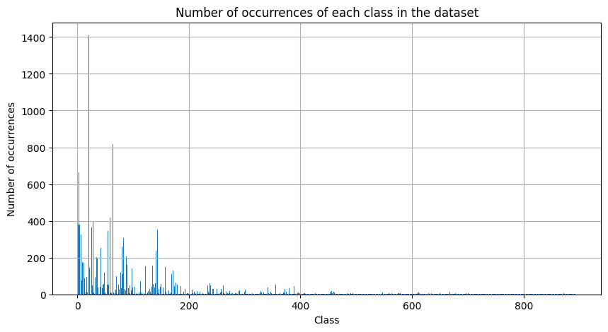
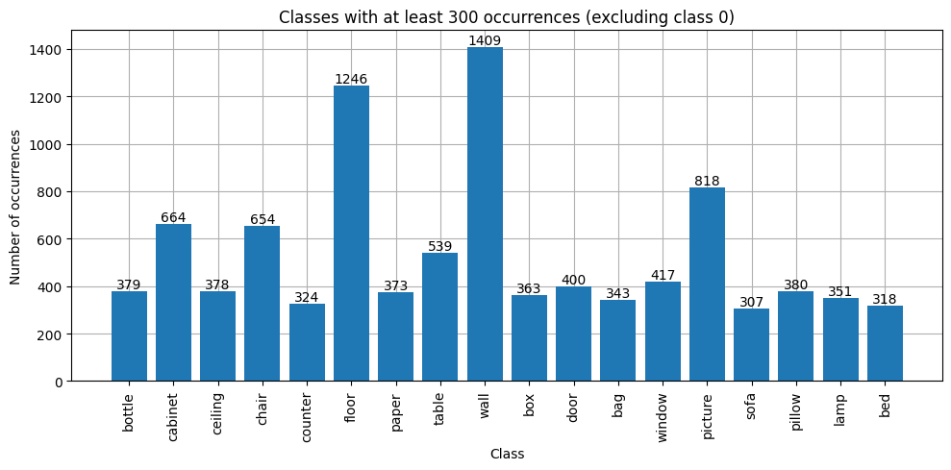
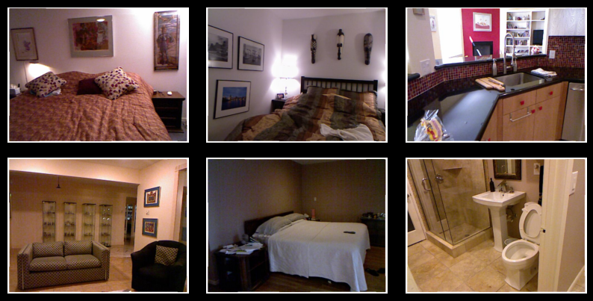
Some challenges with NYU Depth v2
White border
High resolution, low memory
894 classes with just 1449 images

Slide 4
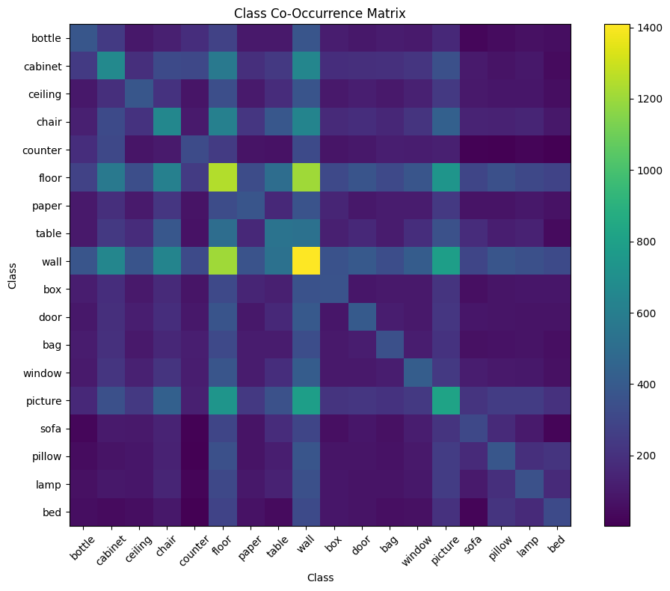
Ensuring the model will be able to learn the classes

Slide 5

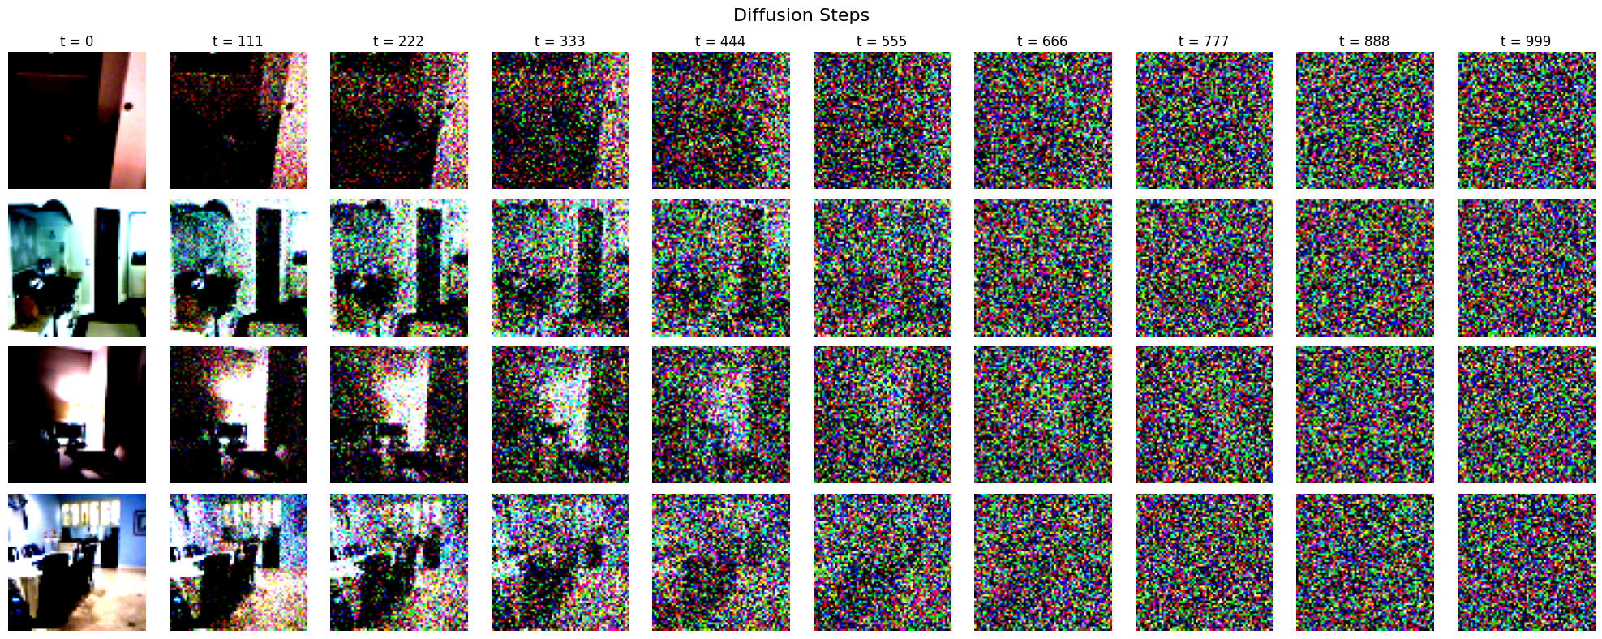
Preprocessing
Per-class overlap, average
Standardized / Normalized Images
Class Conditioning Vector
Depth Conditioning Vector

Slide 6
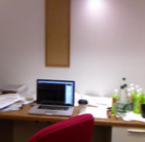
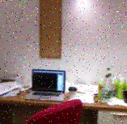
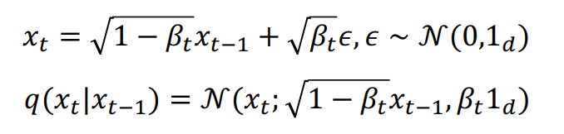
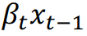
DDPM Paper Inspiration
Ho et al. (2020)
Diffusion Scheduler

Slide 7
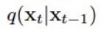
Implementing DDPM Paper
Forward Diffusion

Slide 8
Models
Up Block
Down Block
Upsample
Baseline U-Net
Conv2d
GroupNorm
GroupNorm
Down 1
GELU
Double Conv Block x2
GELU
Bottleneck
Double Conv Block x2
Conv2d
Conv2d
Up 1
GroupNorm
GroupNorm
SiLU
SiLU
Emb
Emb
Linear
Linear

Slide 9
Models
Vanilla U-Net
Down 1
Down 2
Down 3
Bottleneck 1 (256->512)
Bottleneck 2 (512->512)
Bottleneck 3 (512->256)
Up 1
Up 2
Up 3

Slide 10
Models
Attention U-Net
Down 1
Down 2
SelfAttention
Down 3
Bottleneck 1 (256->512)
Key Proj
Bottleneck 2 (512->512)
Query Proj
Bottleneck 3 (512->256)
Value Proj
Up 1
Up 2
Up 3

Slide 11
Metrics
Peak Signal to Noise Ratio (PSNR)
Fréchet Inception Distance (FID)
Focuses on pixel-level differences
Smooth outputs = High PSNR
Aligns more closely with human perception
Was trained on ImageNet
Compares real images with generated with semantics

Slide 12
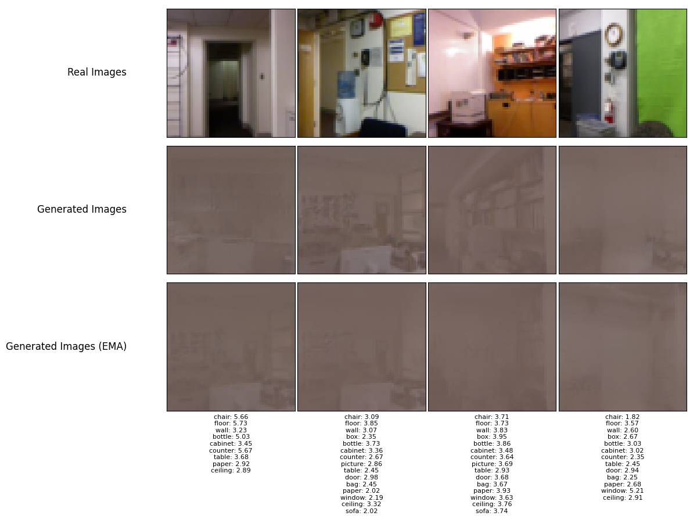
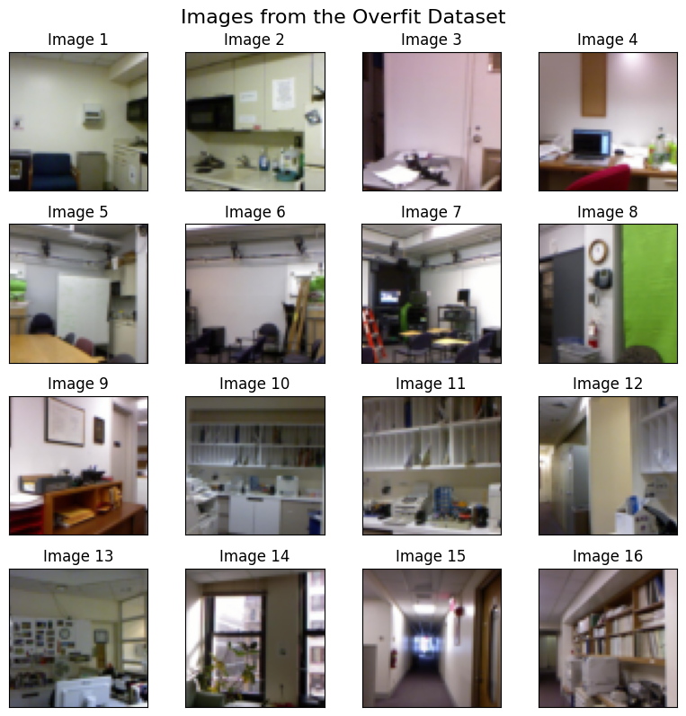
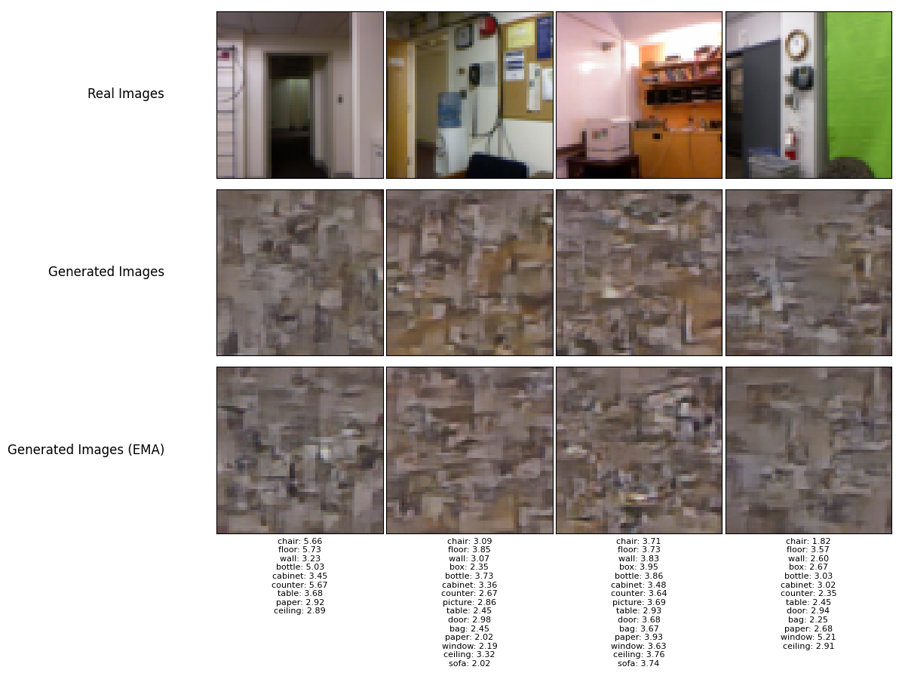
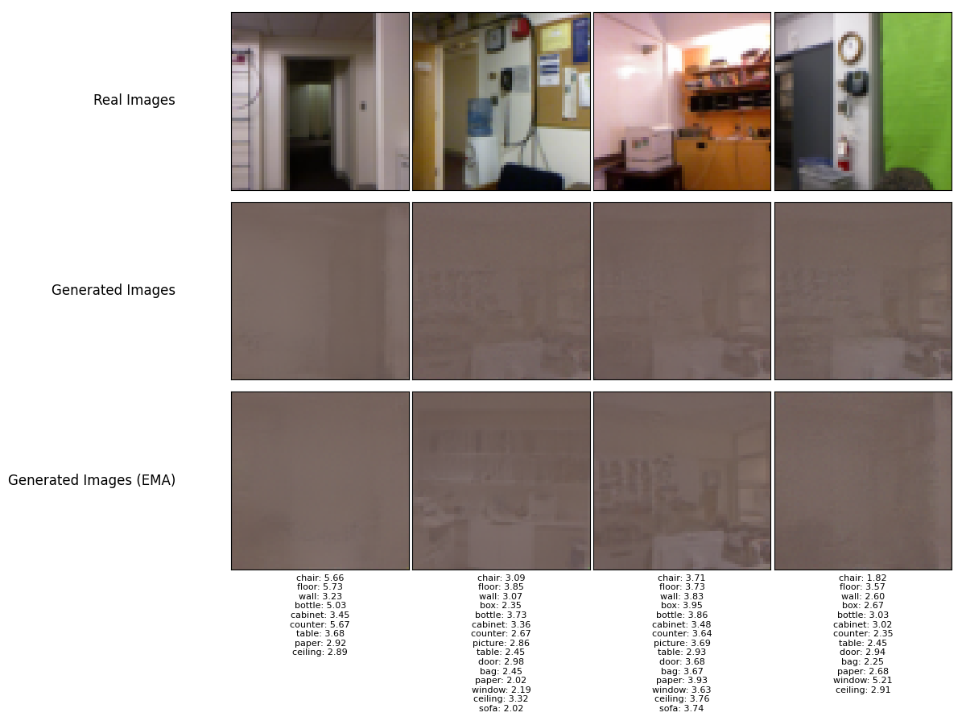
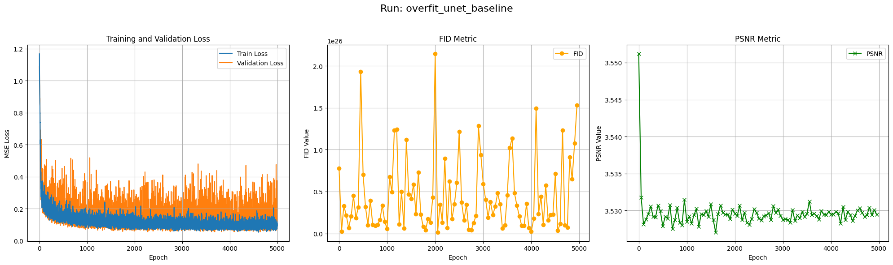
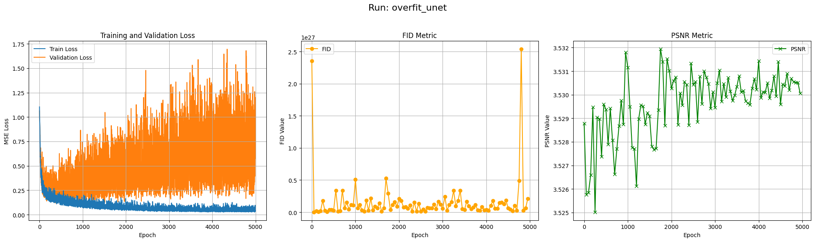
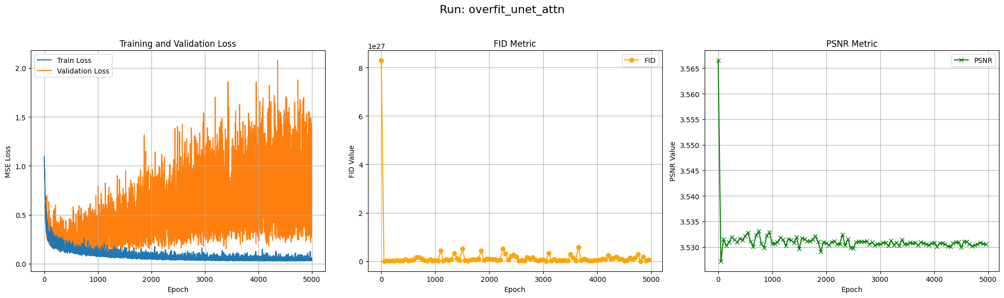
Overfit Results

Slide 13
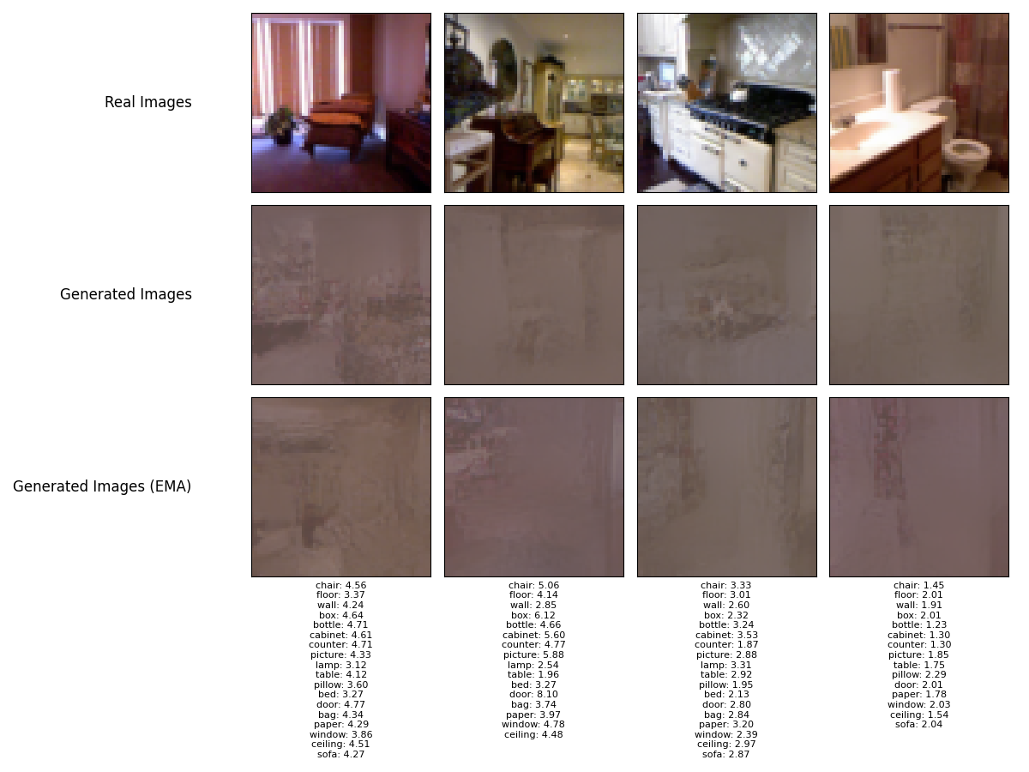
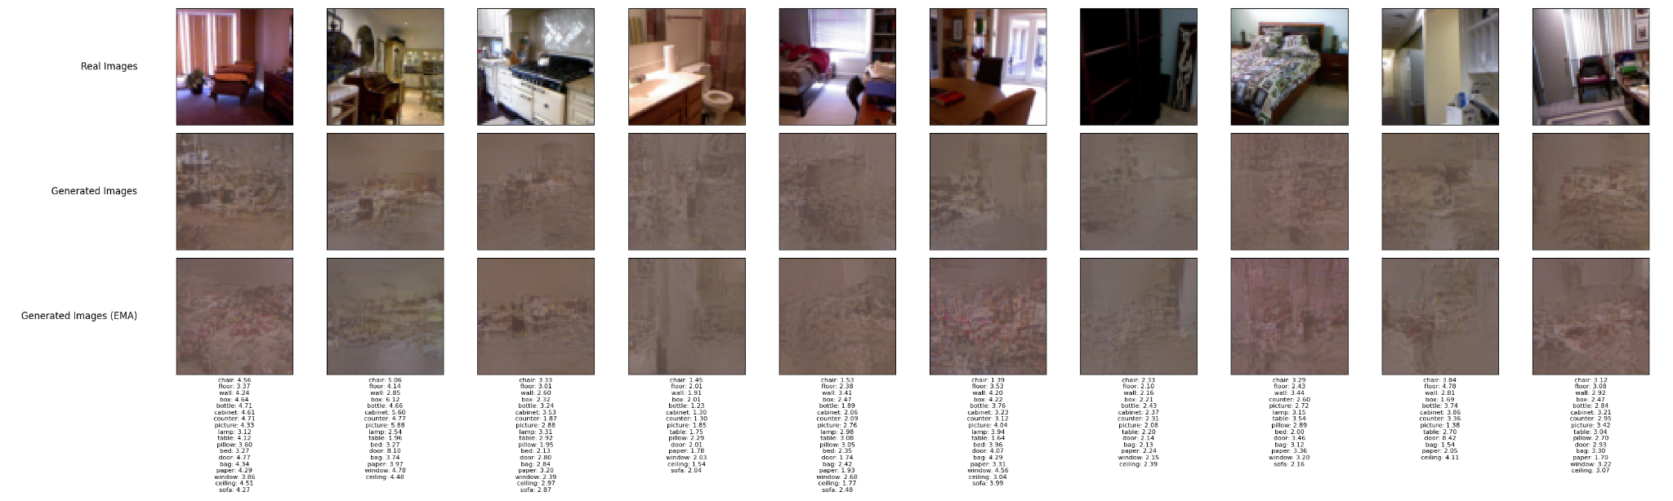
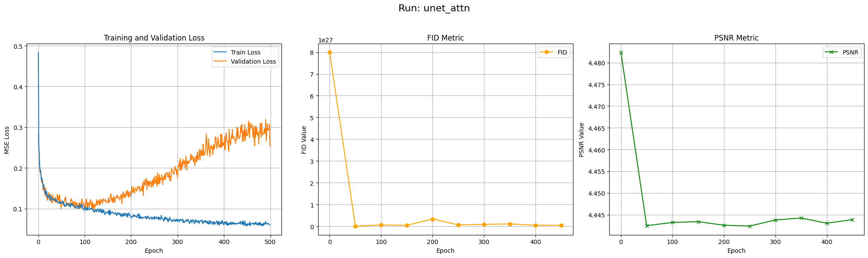
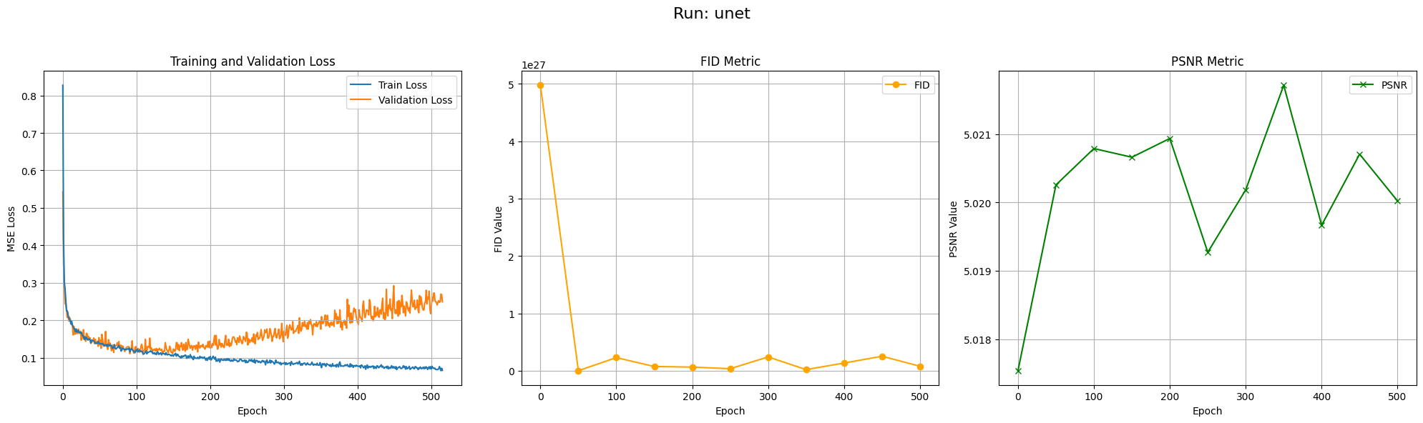
Training on entire dataset

Slide 14
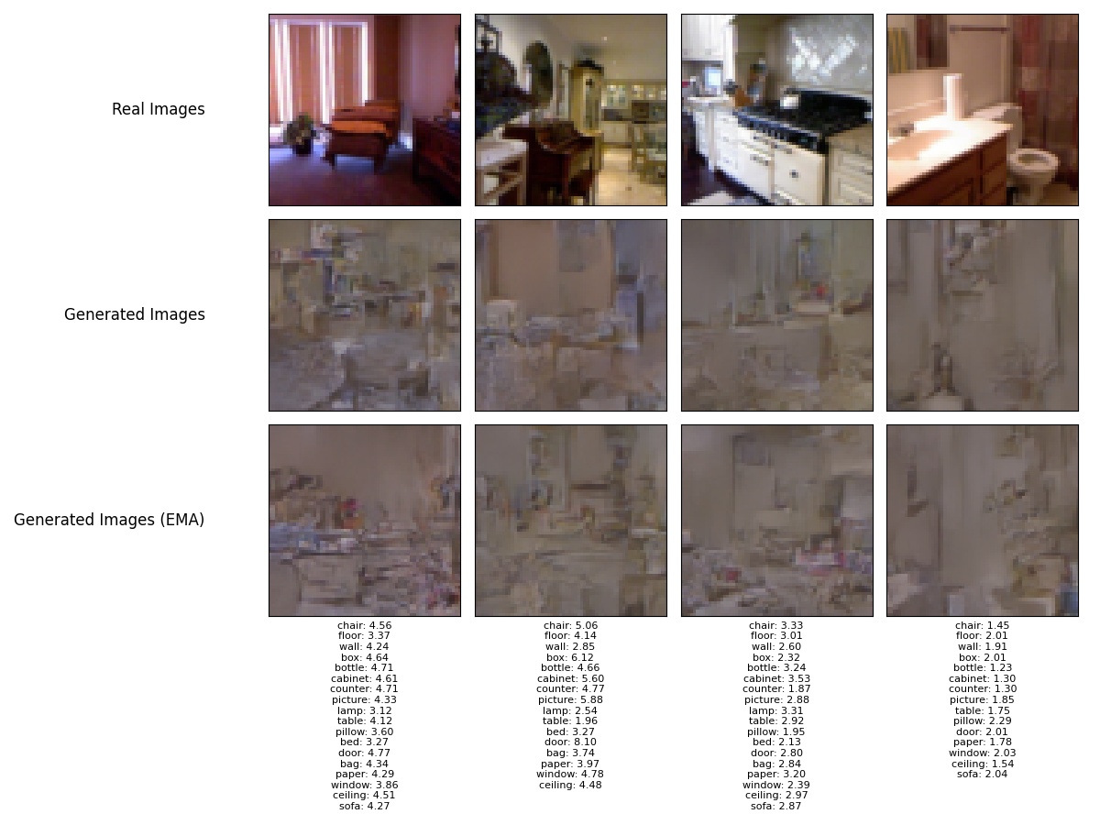
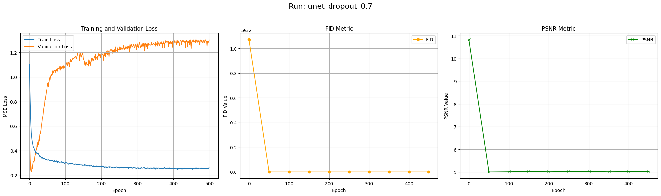
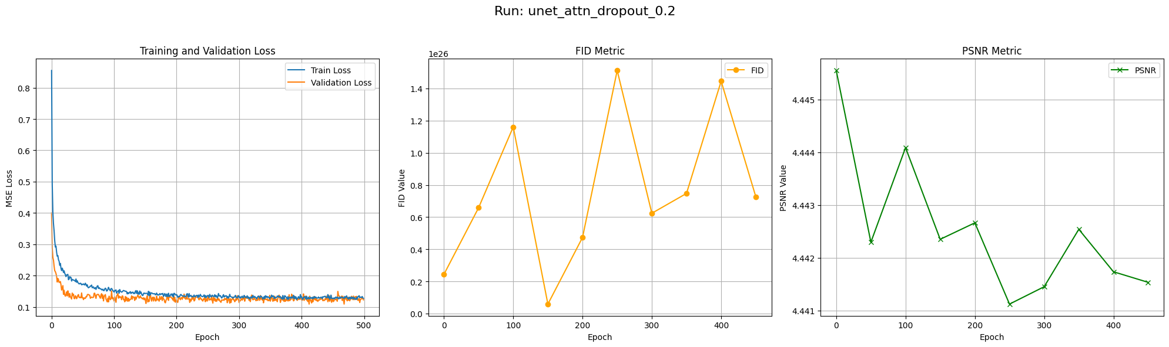
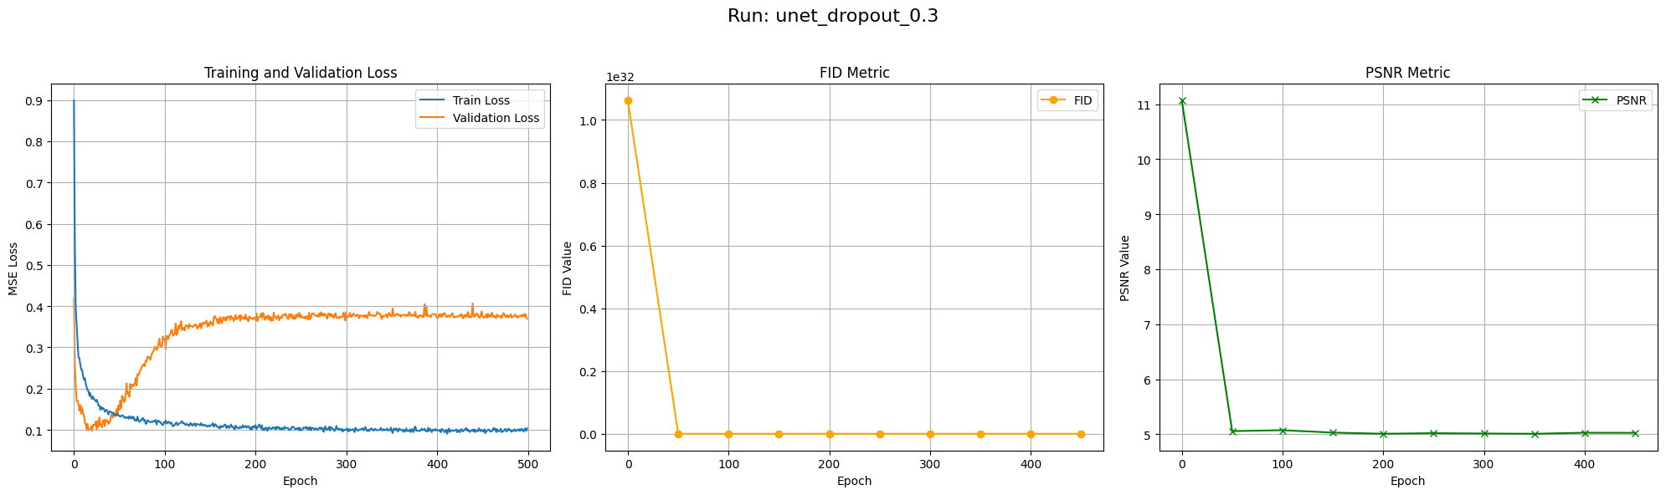
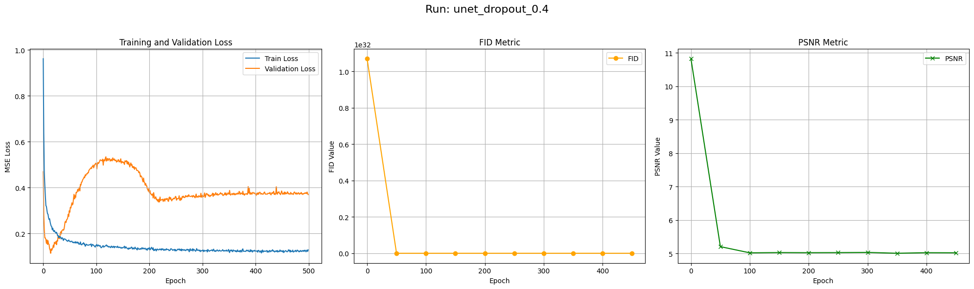
Training with Dropout Regularization

Slide 15
What could prevent the model from collapsing into this single-toned color space?

Slide 16
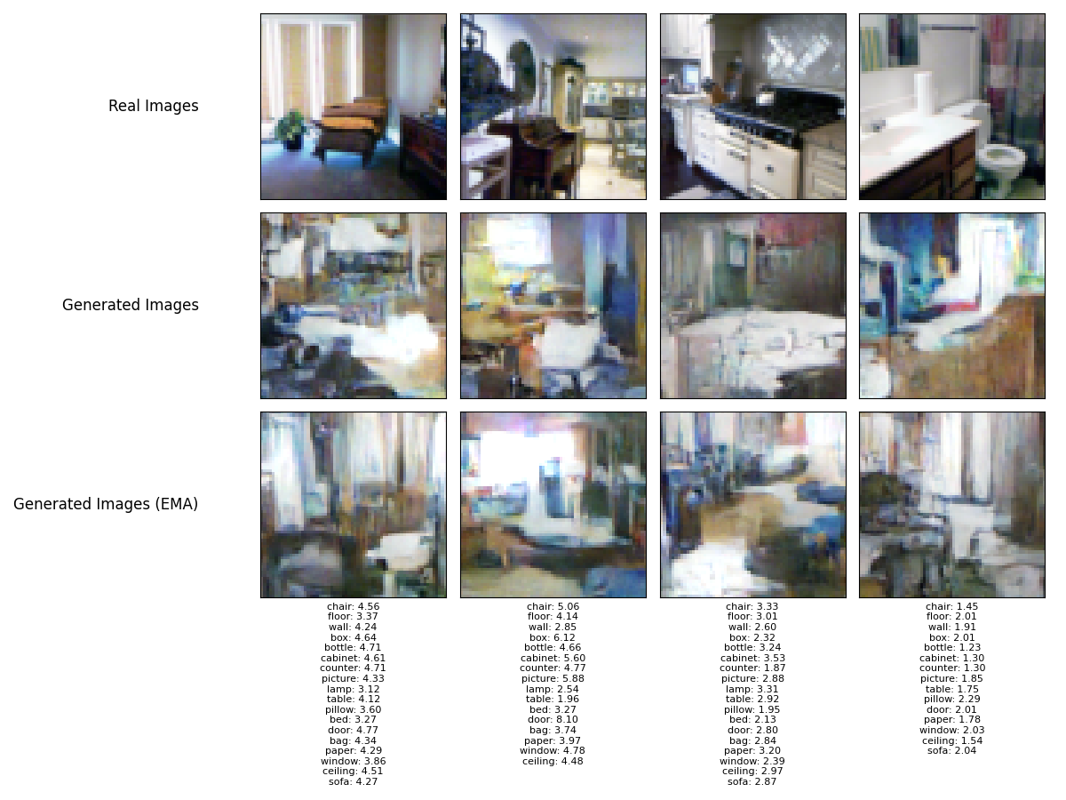
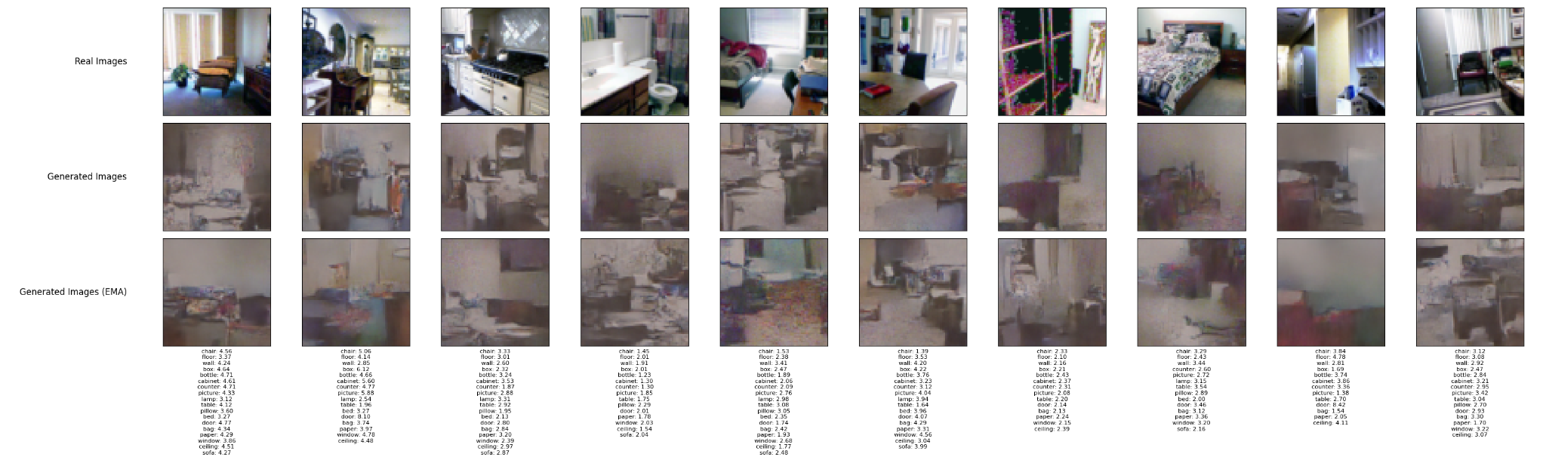
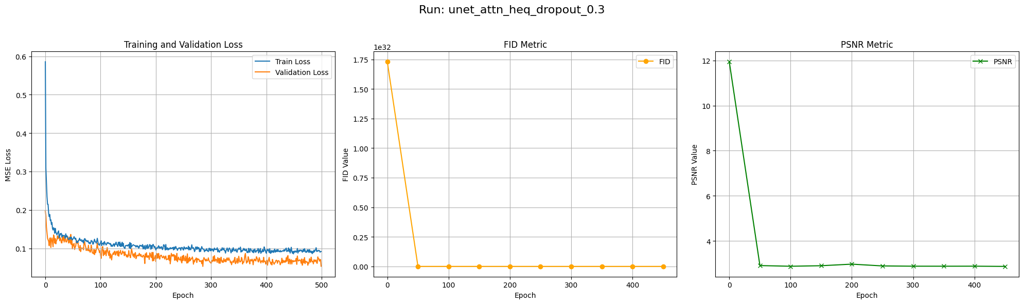
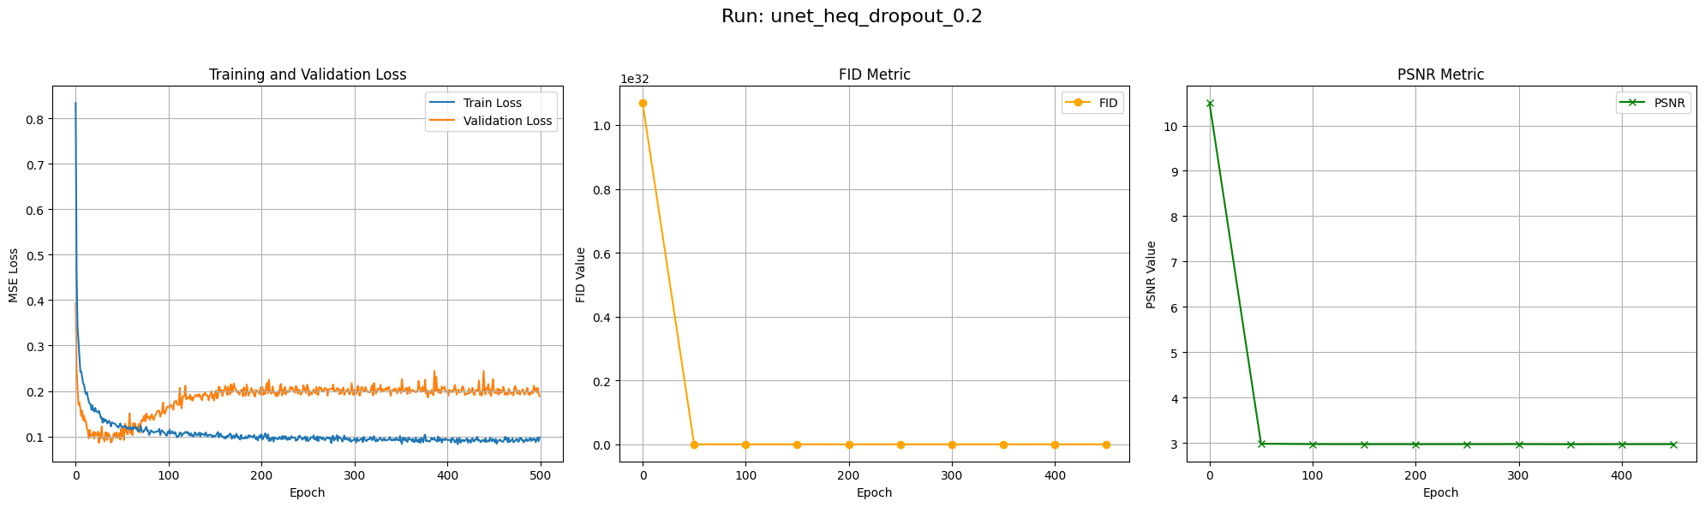
Training with Histogram Equalization + Regularization

Slide 17
Conclusion
Dataset is quite complex
Color space is relatively uniform
Histogram Equalization was a game changer

Slide 18
Outlook
Metrics
Linear vs. Cosine Noise Schedule
Preprocessing needs improvement (i.e. a pipeline)
Classifier Free Guidance

